Slide 1
META-ANALYSIS
F.A.ISKAKOVA

Slide 2
Meta-Analysis
“Meta-analysis is a statistical technique for combining the results of independent, but similar, studies to obtain an overall estimate of treatment effect.”
Margaliot, Zvi, Kevin C. Chung. “Systematic Reviews: A Primer for Plastic Surgery Research.” PRS Journal. 120/7 (2007) p.1840

Slide 3
Meta-Analysis (cont.)
“While all meta-analyses are based on systematic review of literature, not all systematic reviews necessarily include meta-analysis.”
Margaliot, Zvi, Kevin C. Chung. “Systematic Reviews: A Primer for Plastic Surgery Research.” PRS Journal. 120/7 (2007) p.1840

Slide 4
Meta-Analysis (cont.)
“If a meta-analysis is to be included in a systematic review, an experienced statistician or an epidemiologist should be consulted during all phases of the study.”
Margaliot, Zvi, Kevin C. Chung. “Systematic Reviews: A Primer for Plastic Surgery Research.” PRS Journal. 120/7 (2007) p.1840

Slide 5
Meta-analysis (cont.)
“Protocols for the reporting of meta-analysis results were developed for RCTs (Quality of Reports of Meta-analysis [QUOROM] and Observational Studies in Epidemiology [MOOSE].”
Kevin C. Chung, MD, Patricia B. Burns, MPH, H. Myra Kim, ScD. “Clinical Perspective: A Practical Guide to Meta-Analysis.” The Journal of Hand Surgery. Vol.31A No.10 December 2006. p. 1672

Slide 6
Protocols
The purpose of QUOROM and MOOSE guidelines is to provide proper procedures for conducting a meta-analysis and to standardize the methods of reporting a meta-analysis.
Kevin C. Chung, MD, Patricia B. Burns, MPH, H. Myra Kim, ScD. “Clinical Perspective: A Practical Guide to Meta-Analysis.” The Journal of Hand Surgery. Vol.31A No.10 December 2006. p. 1672

Slide 7
Steps of Meta-analysis
Define the Research Question
Perform the literature search
Select the studies
Extract the data
Analyze the data
Report the results

Slide 8
Meta-analysis: The Research Question
“Common questions addressed in meta-analysis are whether one treatment is more effective than another or if exposure to a certain agent will result in disease.”
Kevin C. Chung, MD, Patricia B. Burns, MPH, H. Myra Kim, ScD. “Clinical Perspective: A Practical Guide to Meta-Analysis.” The Journal of Hand Surgery. Vol.31A No.10 December 2006. p. 1672

Slide 9
Meta-analysis: Performing the Literature Search
“The literature search is a critical step in the meta-analysis and often the most difficult part.”
Kevin C. Chung, MD, Patricia B. Burns, MPH, H. Myra Kim, ScD. “Clinical Perspective: A Practical Guide to Meta-Analysis.” The Journal of Hand Surgery. Vol.31A No.10 December 2006. p. 1672

Slide 10
Meta-analysis: The Literature Search (cont.)
“The researcher should search more than just MEDLINE to ensure a comprehensive search.”
Kevin C. Chung, MD, Patricia B. Burns, MPH, H. Myra Kim, ScD. “Clinical Perspective: A Practical Guide to Meta-Analysis.” The Journal of Hand Surgery. Vol.31A No.10 December 2006. p. 1673

Slide 11
Meta-analysis:The Literature Search (cont.)
Search for published studies in MEDLINE, EMBASE, and CINAHL.
Search for unpublished clinical trials in the Cochrane Central Register of Controlled Trials

Slide 12
Meta-analysis: Study Selection
“The inclusion and exclusion criteria for studies needs to be defined at the beginning, during the design stage of the meta-analysis.”
  “Factors determining inclusion in the analysis are study design, population characteristics, type of treatment or exposure, and outcome measures.”
  Kevin C. Chung, MD, Patricia B. Burns, MPH, H. Myra Kim, ScD. “Clinical Perspective: A Practical Guide to Meta-Analysis.” The Journal of Hand Surgery. Vol.31A No.10 December 2006. p. 1673

Slide 13
Meta-analysis: Study Selection (cont.)
Meta-analysis needs to be documented
  “One should keep track of the studies included and excluded at each step of the selection process to document the selection process.”
  Kevin C. Chung, MD, Patricia B. Burns, MPH, H. Myra Kim, ScD. “Clinical Perspective: A Practical Guide to Meta-Analysis.” The Journal of Hand Surgery. Vol.31A No.10 December 2006. p. 1673

Slide 14
Meta-analysis: Study Selection (cont.)
“The QUOROM guidelines for reporting a meta-analysis requests that investigators provide a flow diagram of the selection process.”
Kevin C. Chung, MD, Patricia B. Burns, MPH, H. Myra Kim, ScD. “Clinical Perspective: A Practical Guide to Meta-Analysis.” The Journal of Hand Surgery. Vol.31A No.10 December 2006. p. 1673

Slide 15
The Validity of a Meta-analysis
“The validity of a meta-analysis depends on the quality of the studies included, and an assessment of quality is a necessary part of the process.”
Kevin C. Chung, MD, Patricia B. Burns, MPH, H. Myra Kim, ScD. “Clinical Perspective: A Practical Guide to Meta-Analysis.” The Journal of Hand Surgery. Vol.31A No.10 December 2006. p. 1674

Slide 16
Meta-analysis: Extracting the Data
“The type of data to be extracted from each study should be determined in the design phase and a standardized form is constructed to record the data.”
Kevin C. Chung, MD, Patricia B. Burns, MPH, H. Myra Kim, ScD. “Clinical Perspective: A Practical Guide to Meta-Analysis.” The Journal of Hand Surgery. Vol.31A No.10 December 2006. p. 1674

Slide 17
Meta-analysis: Data
What are the examples of data commonly extracted?
  Study design, descriptions of study groups, diagnostic information, treatments, length of follow-up evaluation, and outcome measures.

Slide 18
Meta-analysis: Data
“The difficulty with data extraction is that studies often use different outcome metrics, which make combining the data awkward. The data should be converted to a uniform metric for pooling.”
Kevin C. Chung, MD, Patricia B. Burns, MPH, H. Myra Kim, ScD. “Clinical Perspective: A Practical Guide to Meta-Analysis.” The Journal of Hand Surgery. Vol.31A No.10 December 2006. p. 1674

Slide 19
Meta-analysis: Analyzing the Data
There are 2 statistical models used in a meta-analysis:
  Fixed effects
  Random effects

Slide 20
The Fixed Effects Model
“The fixed-effects model assumes that the true effect of treatment is the same for every study.”
Kevin C. Chung, MD, Patricia B. Burns, MPH, H. Myra Kim, ScD. “Clinical Perspective: A Practical Guide to Meta-Analysis.” The Journal of Hand Surgery. Vol.31A No.10 December 2006. p. 1675

Slide 21
The Random Effects Model
“The random effects model assumes that the true effect estimate for each study vary.”
Kevin C. Chung, MD, Patricia B. Burns, MPH, H. Myra Kim, ScD. “Clinical Perspective: A Practical Guide to Meta-Analysis.” The Journal of Hand Surgery. Vol.31A No.10 December 2006. p. 1672

Slide 22
Meta-analysis: Reporting the Results
A meta-analysis should include:
  A title, abstract, an introduction
  Methods, results, and discussion sections

Slide 23
The Introduction
“The introduction should indicate the clinical question of interest, the hypothesis being tested, the types of treatment or exposure being studied, the study designs to be included, and a description of the study population.”
Kevin C. Chung, MD, Patricia B. Burns, MPH, H. Myra Kim, ScD. “Clinical Perspective: A Practical Guide to Meta-Analysis.” The Journal of Hand Surgery. Vol.31A No.10 December 2006. p. 1675

Slide 24
The Methods Section
“The methods section should
  describe the literature search, specifically the databases used, and if the search was restricted in any way.
  The selection process for articles, quality assessment, methods of data abstraction, and synthesis.”
  Kevin C. Chung, MD, Patricia B. Burns, MPH, H. Myra Kim, ScD. “Clinical Perspective: A Practical Guide to Meta-Analysis.” The Journal of Hand Surgery. Vol.31A No.10 December 2006. p. 1675

Slide 25
The Results Section
The results section should
  Include a flow chart of studies included
  A figure displaying the results from each individual study (forest plot), results of heterogeneity testing, overall summary statistic, and results of a sensitivity analysis and meta-regression, if performed.
  Kevin C. Chung, MD, Patricia B. Burns, MPH, H. Myra Kim, ScD. “Clinical Perspective: A Practical Guide to Meta-Analysis.” The Journal of Hand Surgery. Vol.31A No.10 December 2006. p. 1675

Slide 26
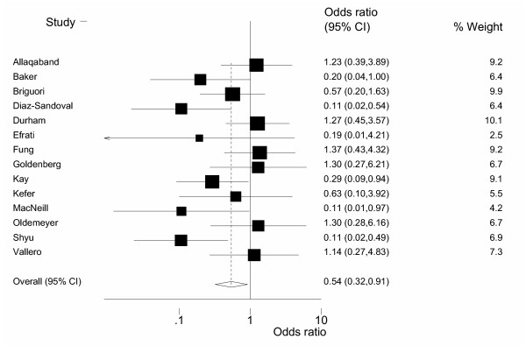
A Forest Plot

Slide 27
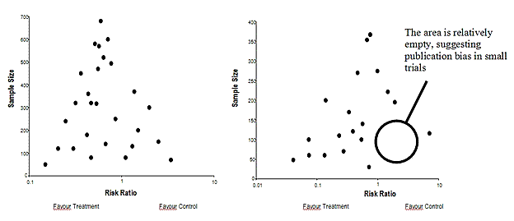
A Funnel Plot
“A funnel plot is used as a way to assess publication bias in meta-analysis.”
Kevin C. Chung, MD, Patricia B. Burns, MPH, H. Myra Kim, ScD. “Clinical Perspective: A Practical Guide to Meta-Analysis.” The Journal of Hand Surgery. Vol.31A No.10 December 2006. p. 1676

Slide 28
Recommended Resources:
“Reading Medical Articles,” in Statistics in Medicine. Robert H. Riffenburgh. 2nd edition. Boston: Academic Press, 2006.
Meta-analysis: New Developments and Applications in Medical and Social Sciences. Ralph Schulze, Heinz Holling, Dankmar Bohning (eds.) Toronto: Hogrefe & Huber Publishers, 2003.
“Finding and Using Health Statistics” - an online course offered by the National Library of Medicine
Margaliot, Zvi, Kevin C. Chung. Systematic Reviews: A Primer for Plastic Surgery Research. PRS Journal. 120/7 2007 .
Kevin C. Chung, MD, Patricia B. Burns, MPH, H. Myra Kim, ScD. “Clinical Perspective: A Practical Guide to Meta-Analysis.” The Journal of Hand Surgery. vol. 31A no.10 December 2006.

Slide 29
Questions?
http://courseinfo.bu.edu/courses/09sprggmsms640_a1/
Thank you!

Slide 31
Home work of class 12
1. Find a scientific paper on Meta-analysis in field of your interest, read, understand and answer questions:
Topic of the article.
Authors
Define the Research Question
iterature search
Select the studies
Extract the data
Analyze the data
Report the results

